Slide 1



SPACELINK
NAME :- ZINZUVADIYA KRISH
ENROLL NO.: 23002170210138
BRANCH : IT
BATCH : C2

Slide 2





INTRODUCTION
SpaceLink provides secure, high-capacity data relay services from space.
Uses optical intersatellite links for fast and secure data transfer.
Connects Low Earth Orbit (LEO) spacecraft with ground stations.
Acts as a "space WiFi" network for real-time connectivity.

Slide 3

MISSIONS
SATELLITE DATA
DEFENSE & INTELLIGENCE
The space economy is growing fast, with LEO satellites providing data for insights on the environment, resources, weather, geopolitics, commerce, and agriculture.
Real-time data is crucial. We measure latency in milliseconds to ensure fast, reliable connectivity for critical missions.
HUMAN SPACEFLIGHT
CIVIL SPACE
Seeing Earth from space is life-changing. With hundreds of bookings, space travel is becoming more accessible, redefining adventure.
NASA's TDRSS connects the ISS and missions, but growing demand calls for higher-capacity commercial infrastructure.

Slide 4
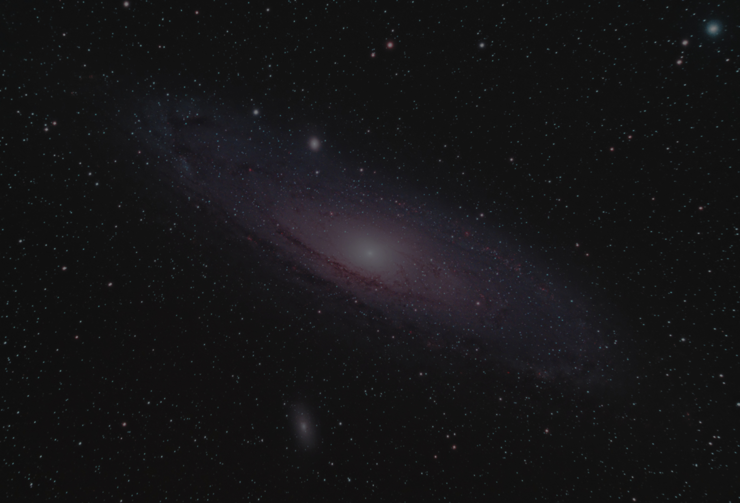




TECHNOLOGIES USED

Slide 5
PROBLEM STATEMENT
DATA LATENCY IN SPACE COMMUNICATION ⏳
SECURITY RISKS IN SPACE COMMUNICATION 🔒
SPACE TRAFFIC & SCALABILITY CHALLENGES 🛰️
Traditional satellite communication has high latency, causing delays in mission-critical data transfer.
Problem: real-time data transmission is crucial for defense, intelligence, and space operations.
Sensitive data (defense, intelligence, space missions) is vulnerable to cyber threats.
Problem: The need for secure, encrypted satellite communications to prevent interception
Growing numbers of satellites increase congestion and risk of communication interference.
Problem: A scalable, interoperable relay network is needed to manage space communication efficiently.

Slide 6




FUTURE ROADMAP
INTEGRATION WITH EMERGING TECHNOLOGIES
Use AI & Machine Learning for predictive analytics in satellite communication.
ENHANCED USER EXPERIENCE
SUSTAINABILITY
Improve UI with better animations and interactive 3D models.
Clean, modern interface with easy navigation.
Develop energy-efficient satellites with solar power.
Implement de-orbiting strategies to reduce space debris.

Slide 7

THANK
YOU

